Slide 1
COMP 4332 / RMBI 4310 Big Data Mining (Spring 2020)
Project 1: Sentiment Classification
TA: Xin Liu (xliucr@connect.ust.hk)

Slide 2
Sentiment Analysis
Generally modeled as classification or regression task
predict a binary or ordinal label

Slide 3
Sentiment Analysis
Simplest task:
Is the attitude of this text positive or negative?
More complex:
Rank the attitude of this text from 1 to 5
(3/5) The room was clean and everything worked fine – even the water pressure
(1/5) …the worst hotel I had ever stayed at ...
Advanced:
Detect the target, source, or complex attitude types

Slide 4
Pipeline
Data Loader: Load data from disks
Feature Extraction: Find useful features
Classification: Classification via different classifiers

Slide 5
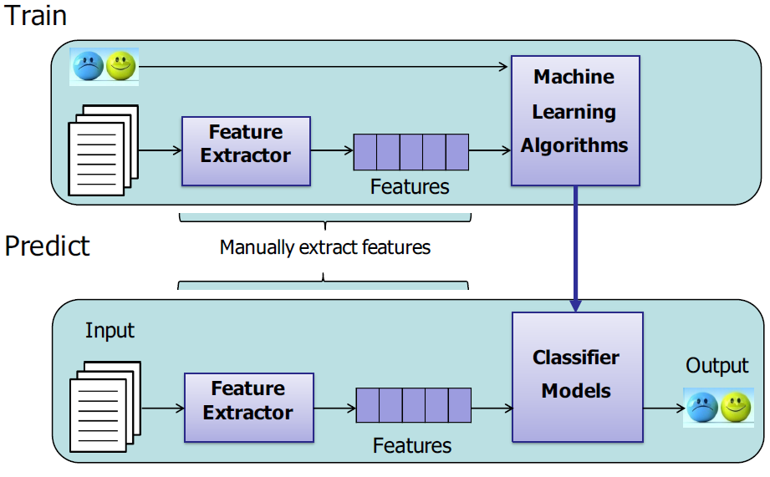
Pipeline

Slide 6
Data Loader
Pandas
def load_data(file_name):
"""
:param file_name: a file name, type: str
return a list of ids, a list of reviews, a list of labels
https://pandas.pydata.org/pandas-docs/stable/generated/pandas.read_csv.html
"""
df = pd.read_csv(file_name)
return df["review_id"], df["text"], df["stars"]
def load_labels(file_name):
"""
:param file_name: a file name, type: str
return a list of labels
"""
return pd.read_csv(file_name)["stars"]
def write_predictions(file_name, pred):
df = pd.DataFrame(zip(range(len(pred)), pred))
df.columns = ["review_id", "stars"]
df.to_csv(file_name, index=False)

Slide 7
Feature Extraction
word occurrence, word frequency, or TF-IDF
This room is clean.
[0,0,1,1,0,1,0,0,1,0,1]
word embedding
cbow, skip-gram, GloVe, fasttext
contextualized word representation
ELMo, BERT, GPT, GPT-2

Slide 8
Feature Extraction
user information
nationality
age
date
weekday or weekend
holiday?
hotel rating
Hilton Hotel
Youth Hostel
data mining

Slide 9
Classification
Naïve Bayes
Logistic Regression
Support Vector Machine
Deep Learning

Slide 10
Multi Layer Perceptron
activation
Output
Hidden
Input
In Tutorial 3
Demo: http://playground.tensorflow.org/

Slide 11
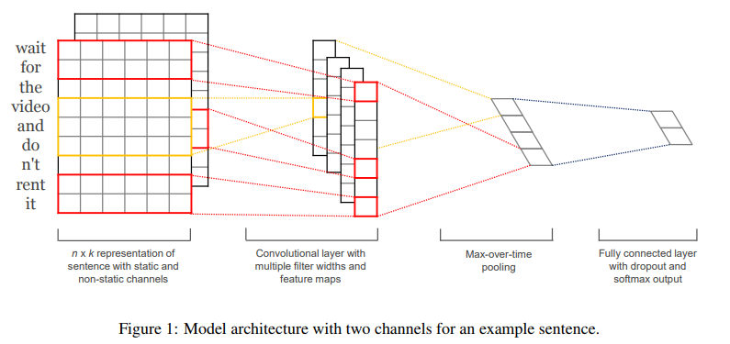
CNN
In Tutorial 4

Slide 12
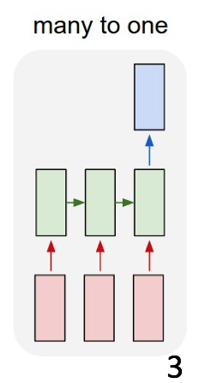
RNN
In Tutorial 5

Slide 13
Dataset
training data: 20000 reviews
validation data: 2000 reviews
test data: 2000 reviews
stars: 1.0-5.0
given features: business_id, cool, date, funny, review_id, text, useful, user_id

Slide 14
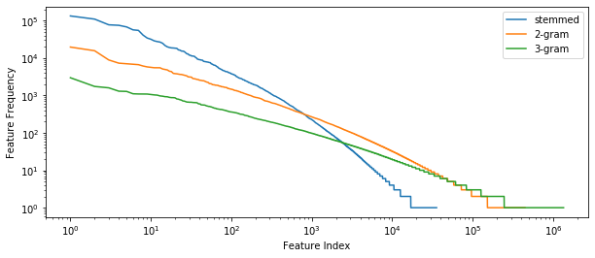
Text Distribution
stemmed feature size: 35531
2-gram feature size: 446252
3-gram feature size: 1345361

Slide 15
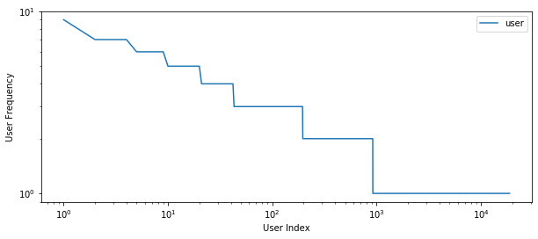
User Distribution
user size: 35531

Slide 16
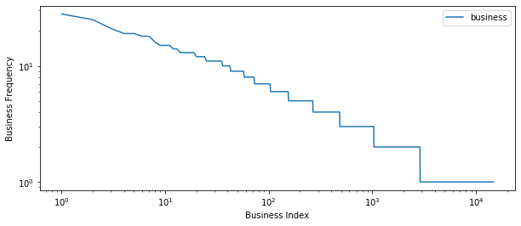
Business Distribution
user size: 14763

Slide 17
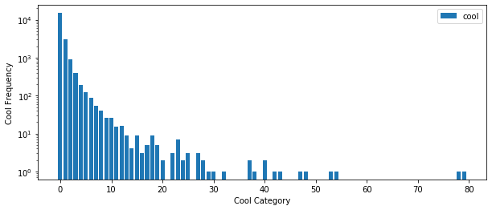
Cool Distribution
user size: 41

Slide 18
More Distributions
You can explore by yourselves.

Slide 19
Evaluation
accuracy on test data

Slide 20
Team up Now!
A team consists of up to 3 students.
Solo is also allowed.
DDL: April 12
2020Spring COMP4332RMBI4330 Term Project Groups.docx

Slide 21
Submission
Predictions on test data (please make sure you can successfully evaluate your validation predictions on the validation data with the help of evaluate.py)
Report (1~2 pages)
Code (Frameworks and even programming languages are not restricted.)
DDL: April 19, 2020
Submission: Each team leader is required to submit the groupNo.zip file that contains pre.csv, the report, and your team’s code on canvas.
we will check your report with your code and the accuracy.

Slide 22
Grading Rule
Grade | Classifier (80%) | Report (20%) | Remark
50% | example code in tutorials or in Project 1 without any modification | submission
60% | an easy baseline that most students can outperform | algorithm you used | release the accuracy on validation data on April 5
80% | a competitive baseline that about half students can surpass | detailed explanation | release the accuracy on validation data on April 5
90% | a very competitive baseline without any special mechanism | detailed explanation and analysis | release the accuracy on validation data on April 12
100% | a very competitive baseline with at least one mechanism | excellent ideas | release the accuracy on validation data on April 12

Slide 23
Thank You

